Slide 1
Chapter 12: Query Processing

Slide 2
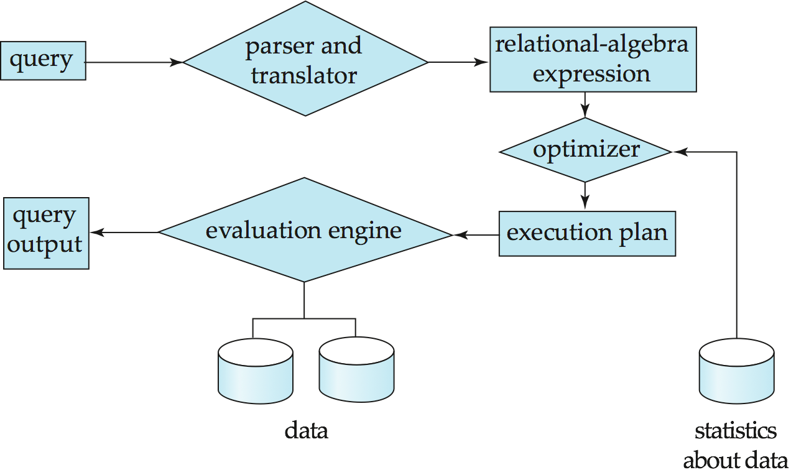
Basic Steps in Query Processing
1. Parsing and translation
2. Optimization
3. Evaluation

Slide 3
Query Processing and Optimization
A relational algebra expression may have many equivalent expressions
E.g., σ_{salary<75000}(∏_{salary}(instructor)) is equivalent to ∏_{salary}(σ_{salary<75000}(instructor))
Each relational algebra operation can be evaluated using one of several different algorithms
We can use an index on salary to find instructors with salary < 75000, or
We can perform complete relation scan (without an index) and discard instructors with salary ≥ 75000
Correspondingly, a relational-algebra expression can be evaluated in one of many ways (algorithms).
An evaluation-plan is an order of evaluating relational algebra expression using certain algorithms.

Slide 4
Query Optimization
Query Optimization: Amongst all equivalent evaluation plans choose the one with lowest cost.
Cost is estimated using statistical information that can be kept in the database catalog.
e.g. number of tuples in each relation, size of tuples, etc.
Query optimization needs to address the following questions.
How to measure query costs
How to select algorithms for evaluating relational algebra operations
How to combine algorithms for individual operations in order to evaluate a complete expression

Slide 5
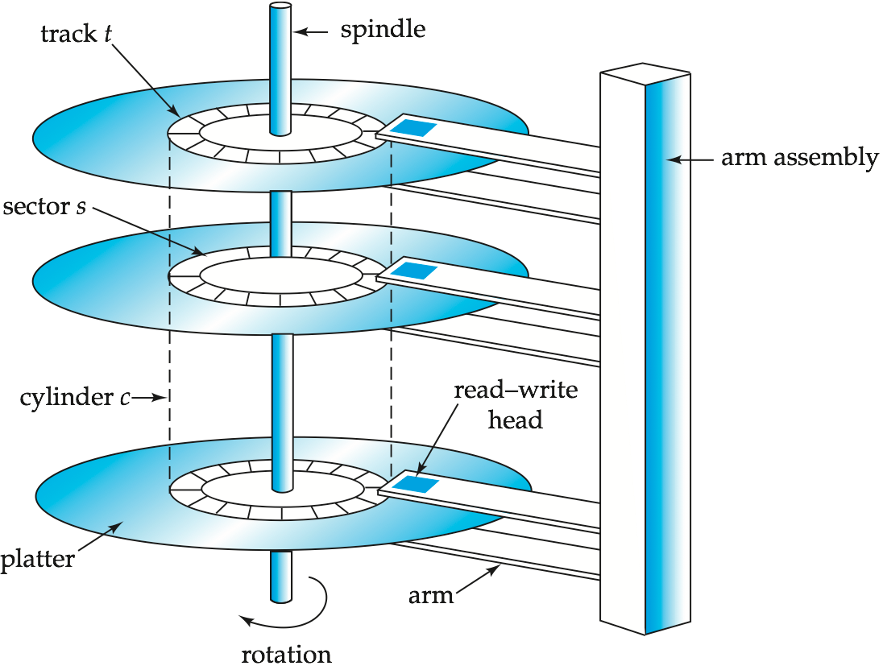
Measures of Query Cost
For simplicity we just use the number of block transfers from disk and the number of seeks as the cost measures
t_{T} – time to transfer one block
t_{S} – time for one seek
Cost for b block transfers plus S seeks b * t_{T} + S * t_{S}
We ignore CPU costs for simplicity.
Real systems do take CPU cost into account.
We do not include cost to writing output to disk in our cost formulae. Why?

Slide 6
An Example on Basic Information
Assume a relation is stored on disk consecutively.
It implies: if you read (or scan) the entire relation, then you only need to do seek once. And, if you read (or scan) the relation from a certain block one-by-one until the end of the relation, then you also need to do seek once.
Choices based on cost estimate
nr the number of records in relation r.
br the number of blocks used by relation r.
SQL examples
select * from student where student.ID = 101.
select * from student where student.ID <= 101.
select * from student where student.Name = ‘Smith’.

Slide 7
Selection Operation
File scan
Algorithm A1 (linear search). Scan each data file block and test all records to see whether they satisfy the selection condition.
Cost estimate = b_{r} block transfers + 1 seek
b_{r} denotes number of blocks containing records from relation r
If selection is on a key attribute, can stop on finding record
cost = (b_{r} /2) block transfers + 1 seek
Linear search can be applied regardless of
selection condition or
ordering of records in the file, or
availability of indices

Slide 8
Selections Using Indices
Index scan – search algorithms that use an index
selection condition must be on search key of an index.
For example, select * from R where R.A = 100
A2 (primary index, equality on key) Retrieve a single record.
Cost = (h_{i} + 1) * (t_{T} + t_{S})
Here, h_{i} is the height of the i-th B+-tree index
“on key” means the search key is a primary/candidate key.
A3 (primary index, equality on nonkey) Retrieve multiple records.
Records will be on consecutive blocks
Let b = number of blocks containing matching records
Cost = h_{i} * (t_{T} + t_{S}) + t_{S} + t_{T} * b

Slide 9
Selections Using Indices
A4 (secondary index, equality on nonkey).
Retrieve a single record if the search key is a candidate key
Cost = (h_{i} + 1) * (t_{T} + t_{S})
Here, “on nonkey” means the search key is not a primary key. Note: a relation can have only one primary key, but may have several candidate keys. A primary key is a candidate key.
Retrieve multiple records if the search-key is not a candidate key
each of n matching records may be on a different block
Cost = (h_{i} + n) * (t_{T} + t_{S})
Can be very expensive!
The number of accesses to the blocks that contain pointers to data records in the data file are ignored. Refer to the secondary index in ch11.
Notes:
9

Slide 10
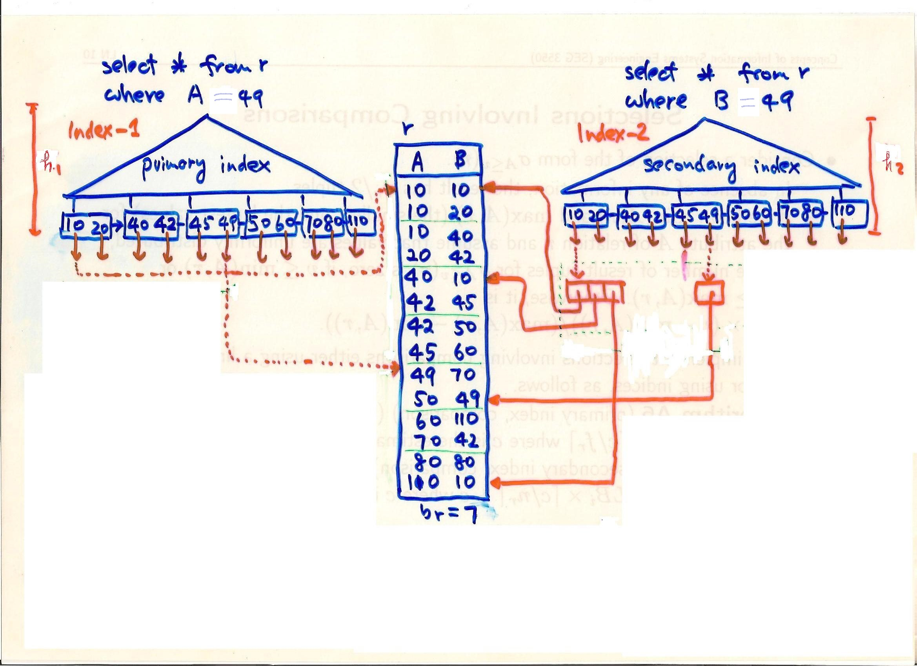
The blocks containing pointers to data records.

Slide 11
Selections Involving Comparisons
Can implement selections of the form σ_{A≤V} (r) or σ_{A ≥ V}(r) by using
a linear file scan,
or by using indices in the following ways:
A5 (primary index, comparison). (Relation is sorted on A)
For σ_{A ≥ V} (r) use index to find the first tuple ≥ v and scan relation sequentially from there
For σ_{A ≤ V} (r) just scan relation sequentially till first tuple > v; do not use index
A6 (secondary index, comparison).
For σ_{A ≥ V} (r) use index to find the first index entry ≥ v and scan index sequentially from there, to find pointers to records.
For σ_{A ≤ V} (r) just scan leaf pages of index finding pointers to records, till first entry > v
In either case, retrieve records that are pointed to
requires an I/O for each record
Linear file scan may be cheaper

Slide 12
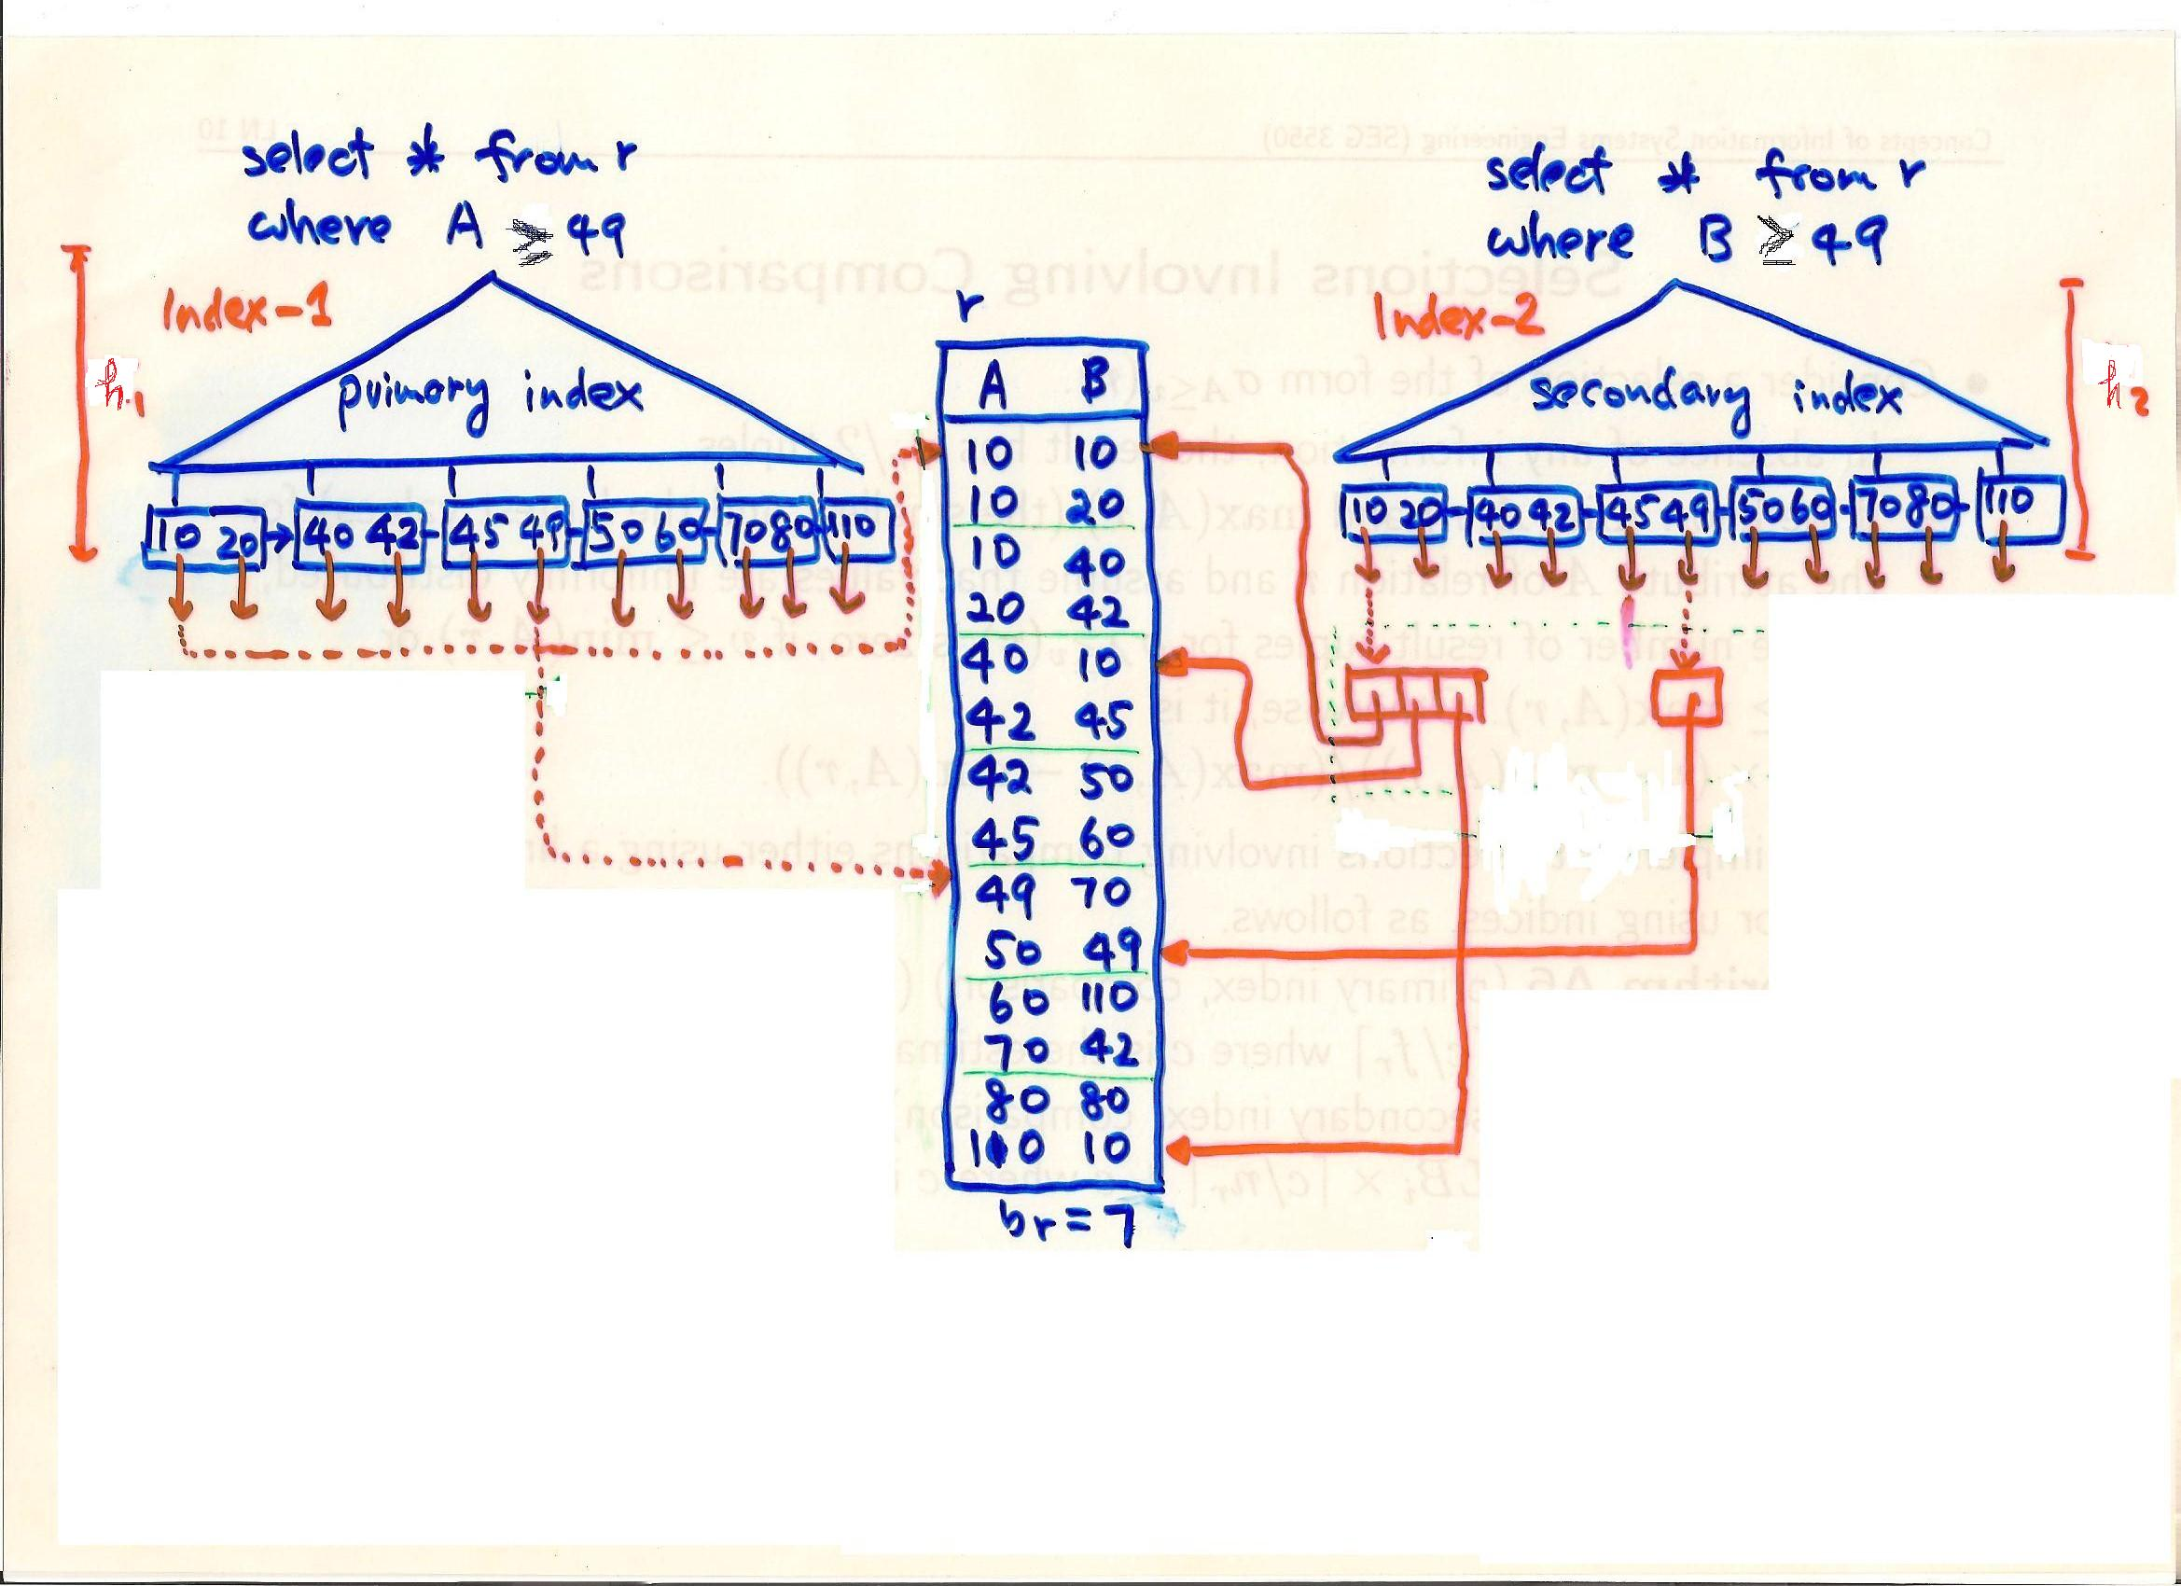
The blocks containing pointers to data records.

Slide 13
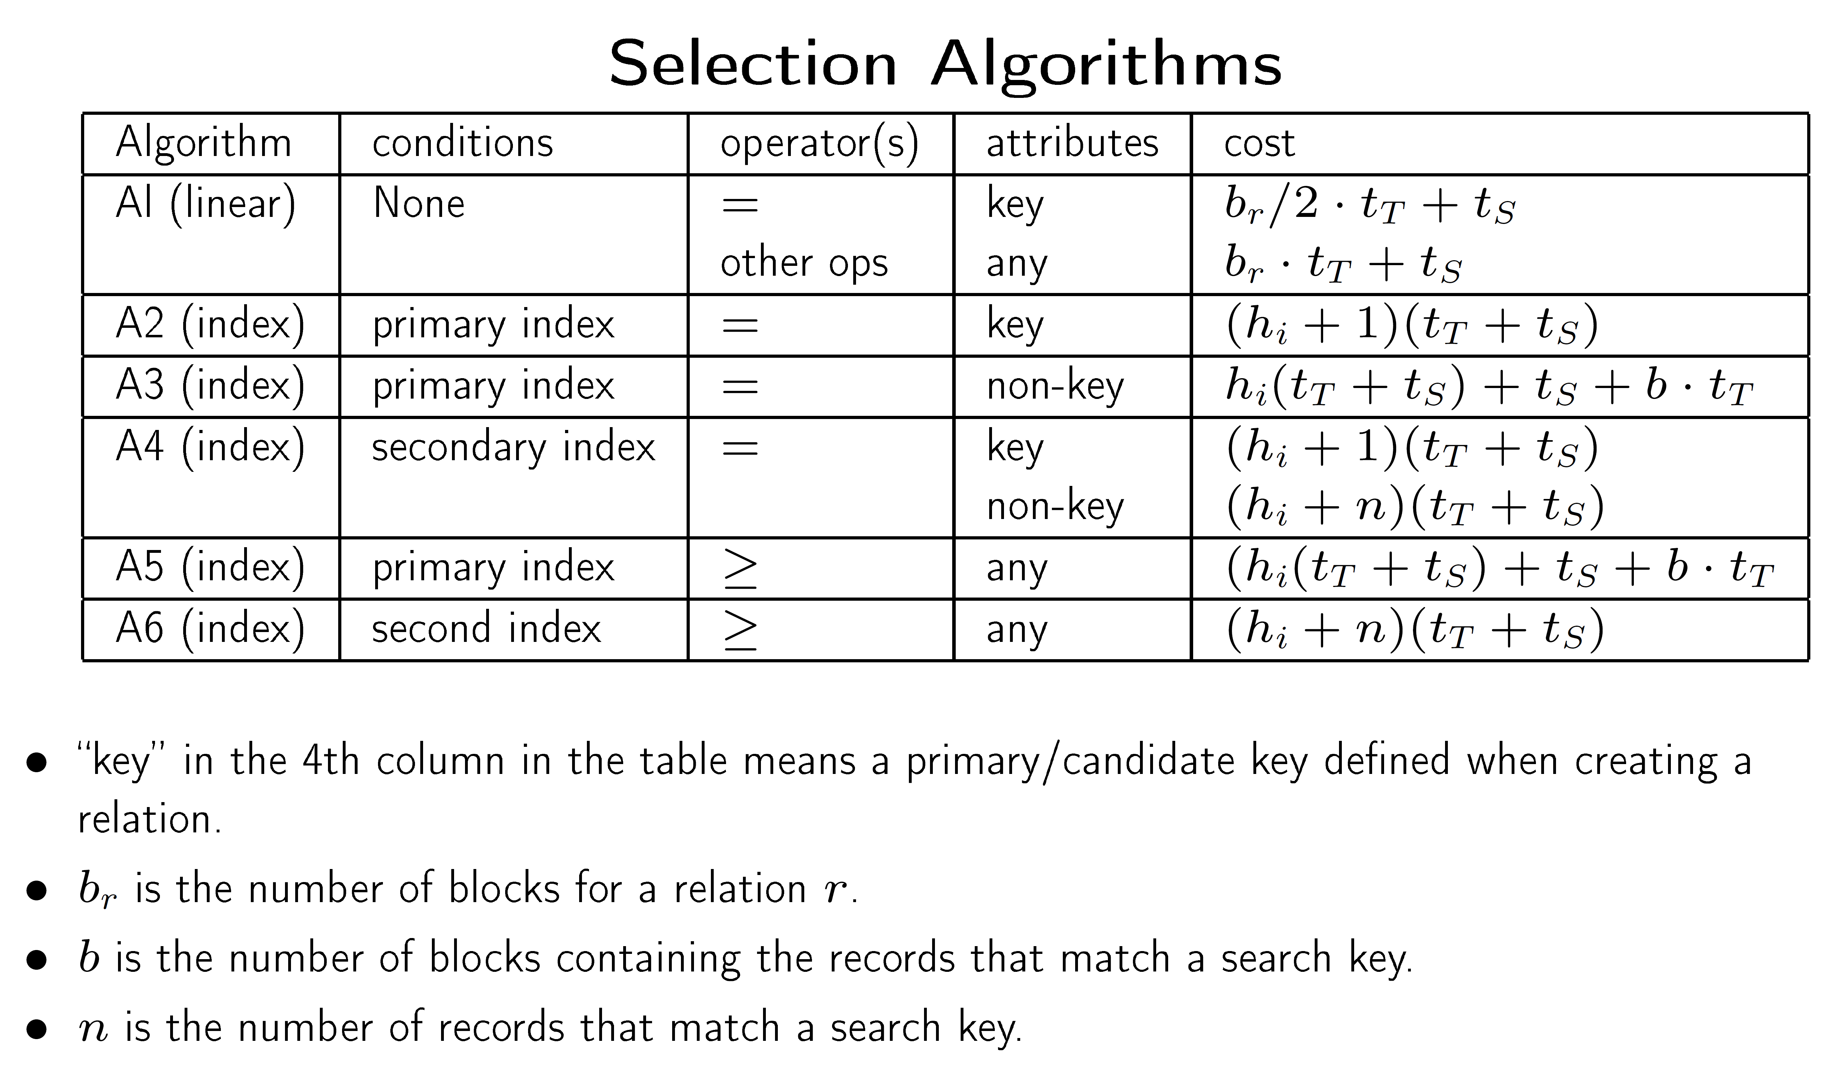

Slide 14
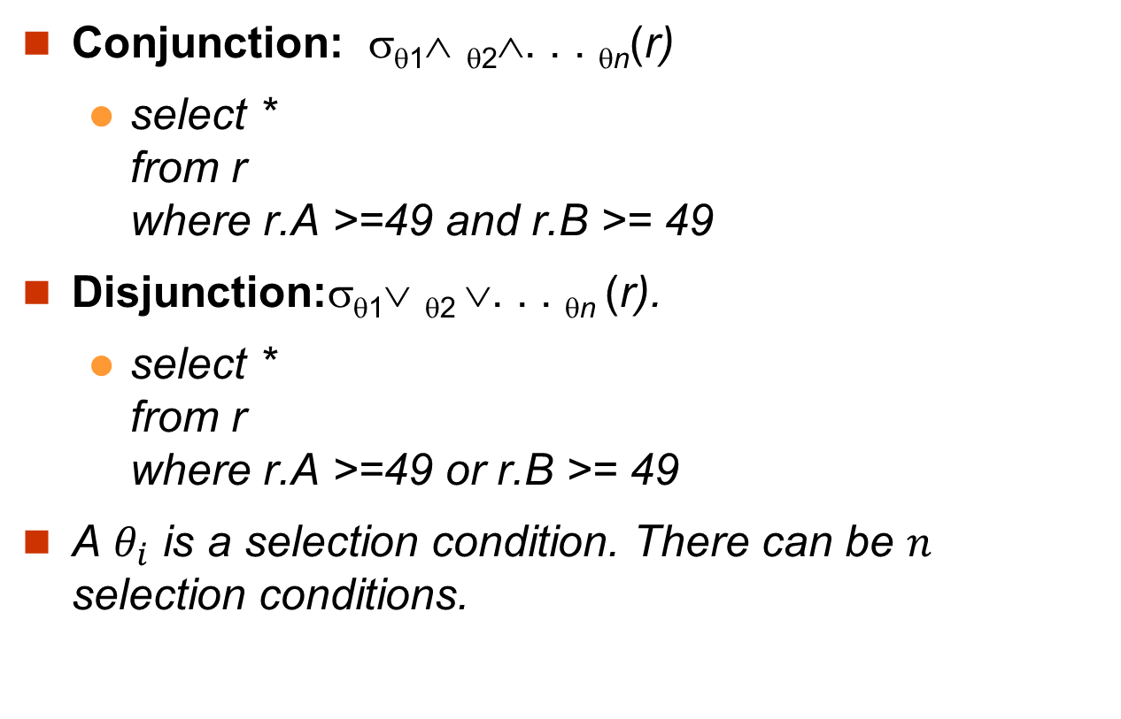
Complex Selections
Conjunction: σ_{θ1}∧ _{θ2}∧. . . _{θn}(r)
select * from r where r.A >=49 and r.B >= 49
Disjunction:σ_{θ1}∨ _{θ2} ∨. . . _{θn} (r).
select * from r where r.A >=49 or r.B >= 49
A $θ_{i}$ is a selection condition. There can be $n$ selection conditions.

Slide 15
Implementation of Complex Selections
Conjunction: σ_{θ1}∧ _{θ2}∧. . . _{θn}(r)
A7 (conjunctive selection using one index).
Select one θ_{i} and an algorithm (A1 through A6) that results in the least cost for σ_{θi} (r).
Test other conditions on tuple after fetching it into memory buffer.
A8 (conjunctive selection using composite index).
Use appropriate composite (multiple-key) index if available.
A9 (conjunctive selection by intersection of identifiers).
Require indices with record pointers.
Use corresponding index for each condition, and take intersection of all the obtained sets of record pointers, denoted as I.
Fetch records from data file using the record pointers in I.
If some conditions do not have appropriate indices, apply test in memory.

Slide 16
Algorithms for Complex Selections
Disjunction:σ_{θ1}∨ _{θ2} ∨. . . _{θn} (r).
A10 (disjunctive selection by union of identifiers).
Applicable if all conditions have available indices.
Use corresponding index for each condition, and take union of all the obtained sets of record pointers, denoted as I.
Then fetch records from file using the pointers in I.
Better to use linear scan to scan the data file.
Negation: σ_{¬θ}(r)
Use linear scan on file.

Slide 17
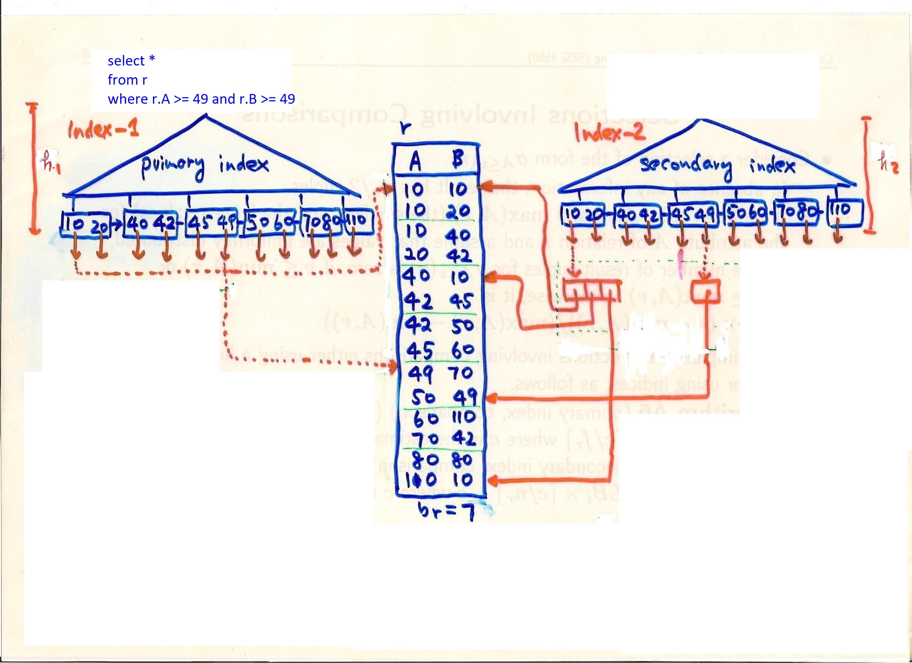
A Conjunction Example

Slide 18
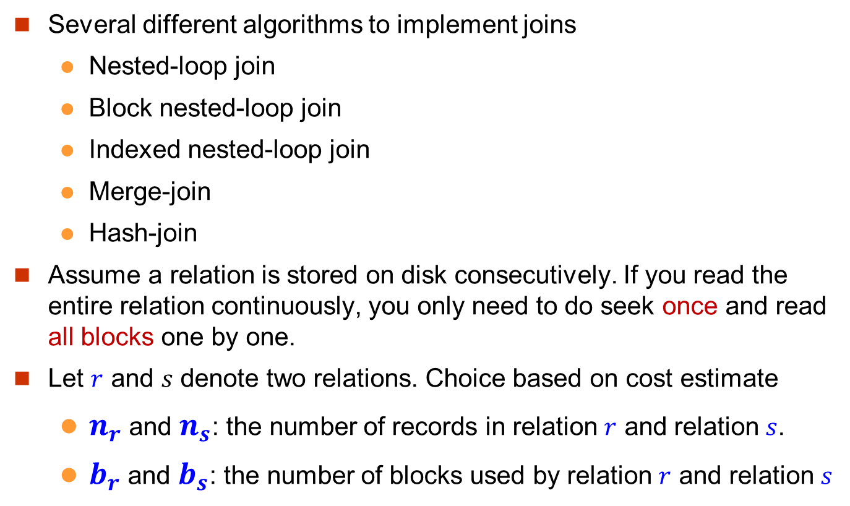
Join Operation
Several different algorithms to implement joins
Nested-loop join
Block nested-loop join
Indexed nested-loop join
Merge-join
Hash-join
Assume a relation is stored on disk consecutively. If you read the entire relation continuously, you only need to do seek once and read all blocks one by one.
Let $r$ and $s$ denote two relations. Choice based on cost estimate
$n_{r}$ and $n_{s}$: the number of records in relation $r$ and relation $s$.
$b_{r}$ and $b_{s}$: the number of blocks used by relation $r$ and relation $s$

Slide 19
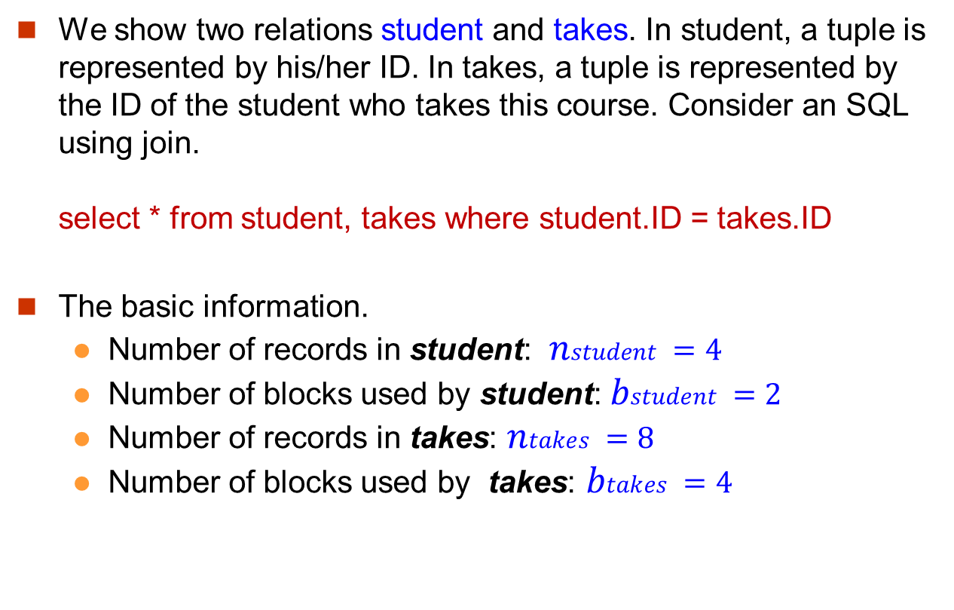
An Example
We show two relations student and takes. In student, a tuple is represented by his/her ID. In takes, a tuple is represented by the ID of the student who takes this course. Consider an SQL using join. select * from student, takes where student.ID = takes.ID
The basic information.
Number of records in student: $nstudent =4$
Number of blocks used by student: $bstudent =2$
Number of records in takes: $ntakes =8$
Number of blocks used by takes: $btakes =4$
student
takes
D1 D2 D3 D4
D1 D4 D2 D3
D1 D2 D1 D4
b1
b2
b1
b2
b3
b4

Slide 20
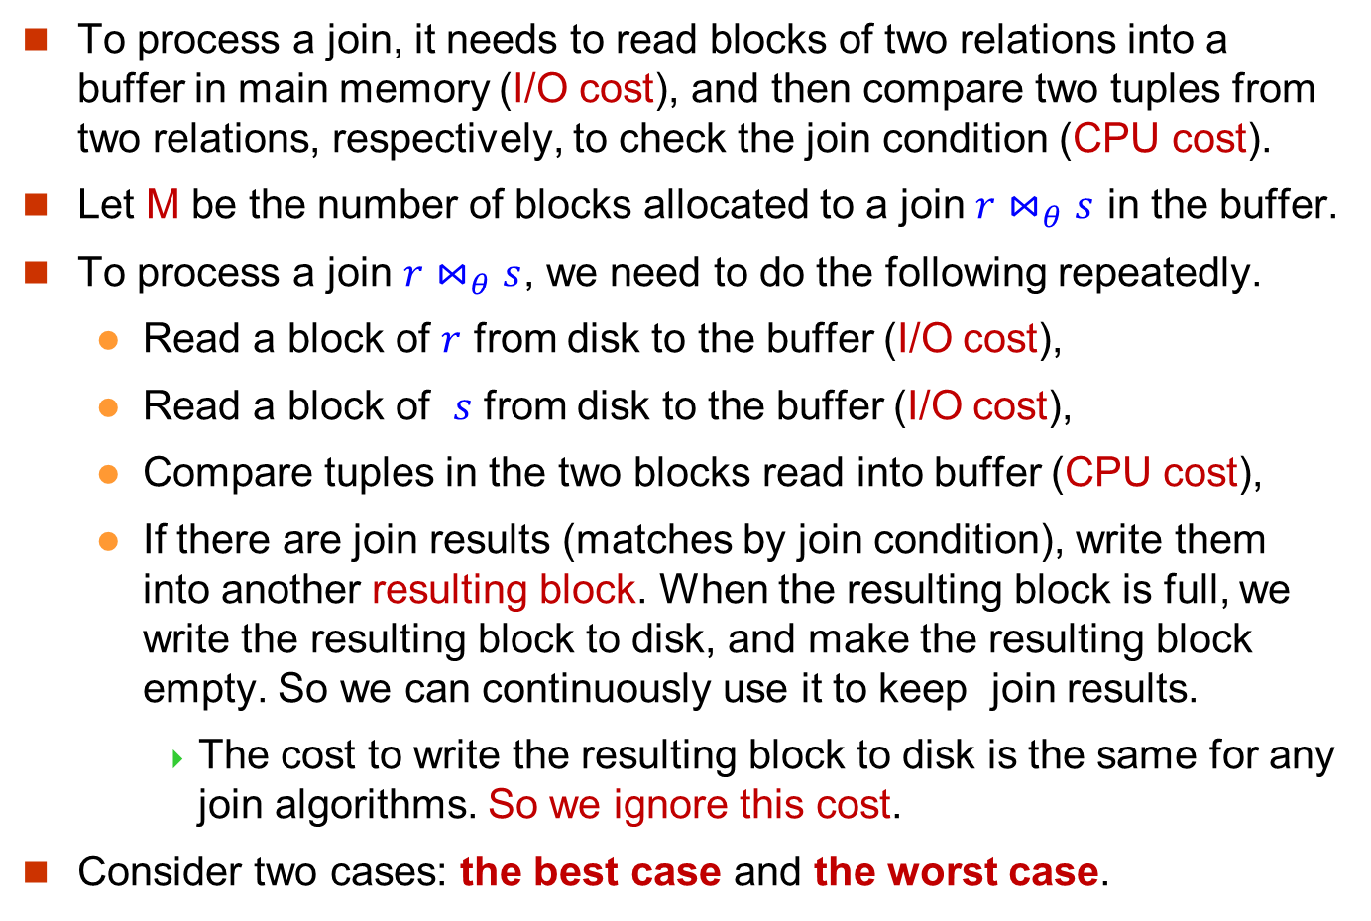
Buffer in Main Memory (1)
To process a join, it needs to read blocks of two relations into a buffer in main memory (I/O cost), and then compare two tuples from two relations, respectively, to check the join condition (CPU cost).
Let M be the number of blocks allocated to a join $r⋈_{θ}s$ in the buffer.
To process a join $r⋈_{θ}s$, we need to do the following repeatedly.
Read a block of $r$ from disk to the buffer (I/O cost),
Read a block of $s$ from disk to the buffer (I/O cost),
Compare tuples in the two blocks read into buffer (CPU cost),
If there are join results (matches by join condition), write them into another resulting block. When the resulting block is full, we write the resulting block to disk, and make the resulting block empty. So we can continuously use it to keep join results.
The cost to write the resulting block to disk is the same for any join algorithms. So we ignore this cost.
Consider two cases: the best case and the worst case.

Slide 21
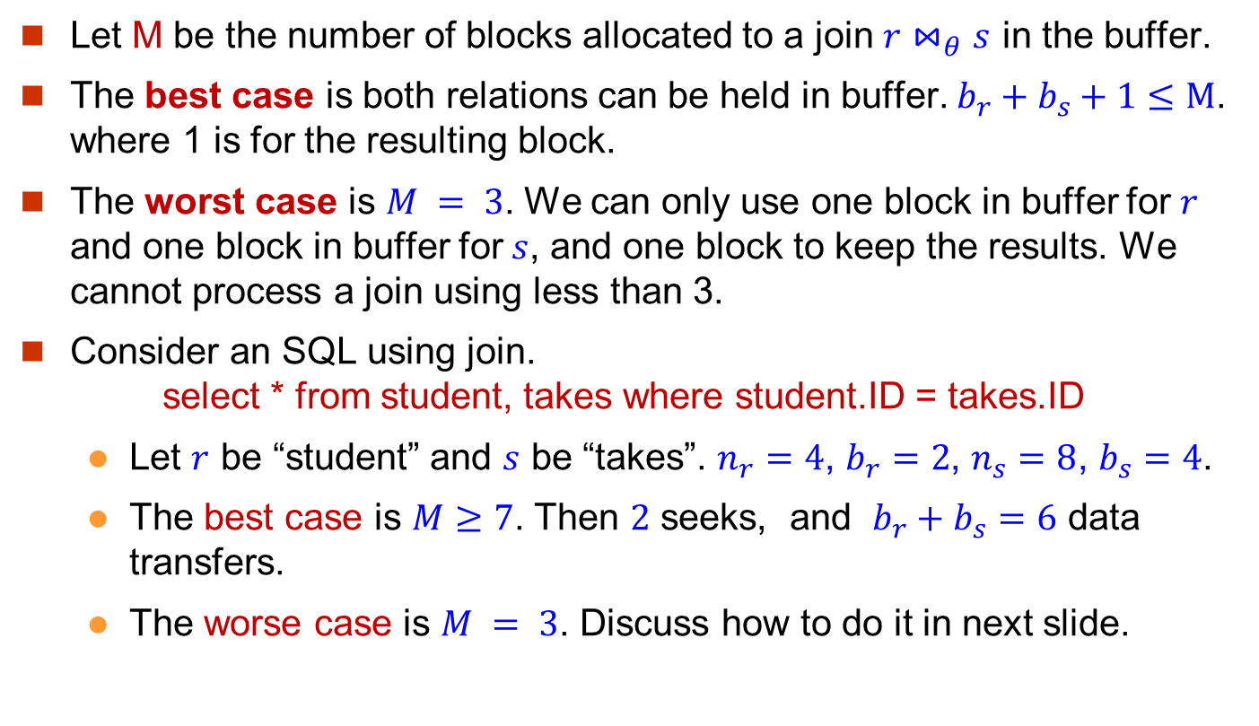
Buffer in Main Memory (2)
Let M be the number of blocks allocated to a join $r⋈_{θ}s$ in the buffer.
The best case is both relations can be held in buffer. $b_{r}+b_{s}+1≤M$. where 1 is for the resulting block.
The worst case is $M = 3$. We can only use one block in buffer for $r$ and one block in buffer for $s$, and one block to keep the results. We cannot process a join using less than 3.
Consider an SQL using join. select * from student, takes where student.ID = takes.ID
Let $r$ be “student” and $s$ be “takes”. $n_{r}=4$, $b_{r}=2$, $n_{s}=8$, $b_{s}=4$.
The best case is $M≥7$. Then $2$ seeks, and $b_{r}+b_{s}=6$ data transfers.
The worse case is $M = 3$. Discuss how to do it in next slide.
student
takes
D1 D2 D3 D4
D1 D4 D2 D3
D1 D2 D1 D4
b1
b2
b1
b2
b3
b4

Slide 22
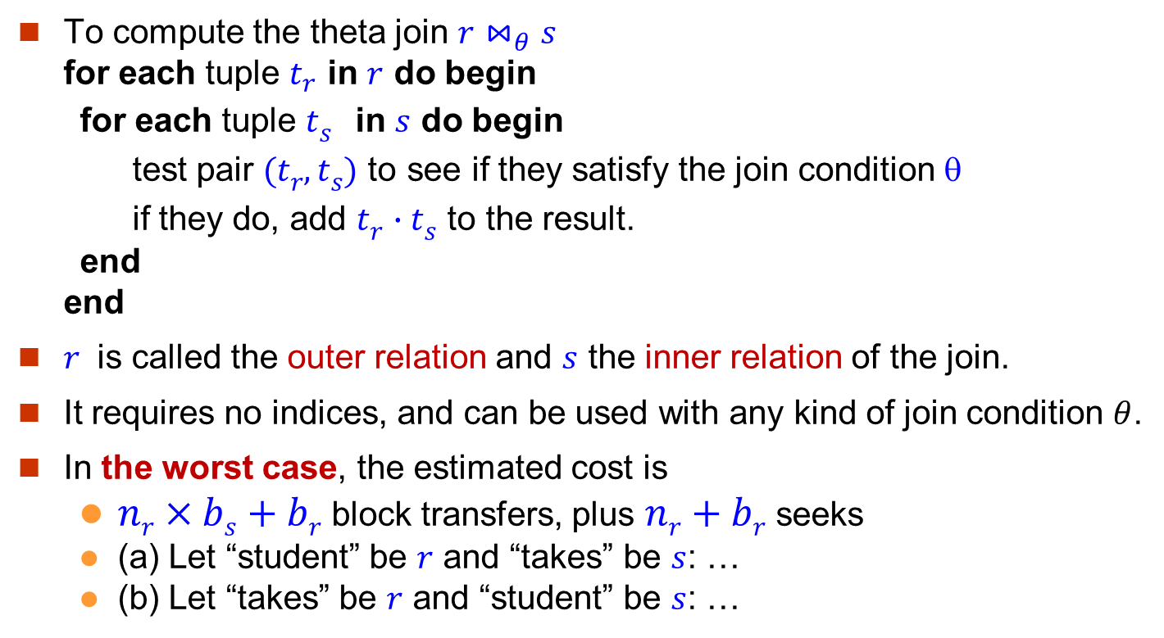
Nested-Loop Join (1)
To compute the theta join $r⋈_{θ}s$ for each tuple $t_{r}$ in $r$ do begin for each tuple $ts$ in $s$ do begin test pair $(tr,ts)$ to see if they satisfy the join condition $$ if they do, add $tr∙ts$ to the result. end end
$r$ is called the outer relation and $s$ the inner relation of the join.
It requires no indices, and can be used with any kind of join condition $θ$.
In the worst case, the estimated cost is
$nr×bs+br$block transfers, plus $nr+br$seeks
(a) Let “student” be $r$ and “takes” be $s$: …
(b) Let “takes” be $r$ and “student” be $s$: …
student
takes
D1 D2 D3 D4
D1 D4 D2 D3
D1 D2 D1 D4
b1
b2
b1
b2
b3
b4

Slide 23
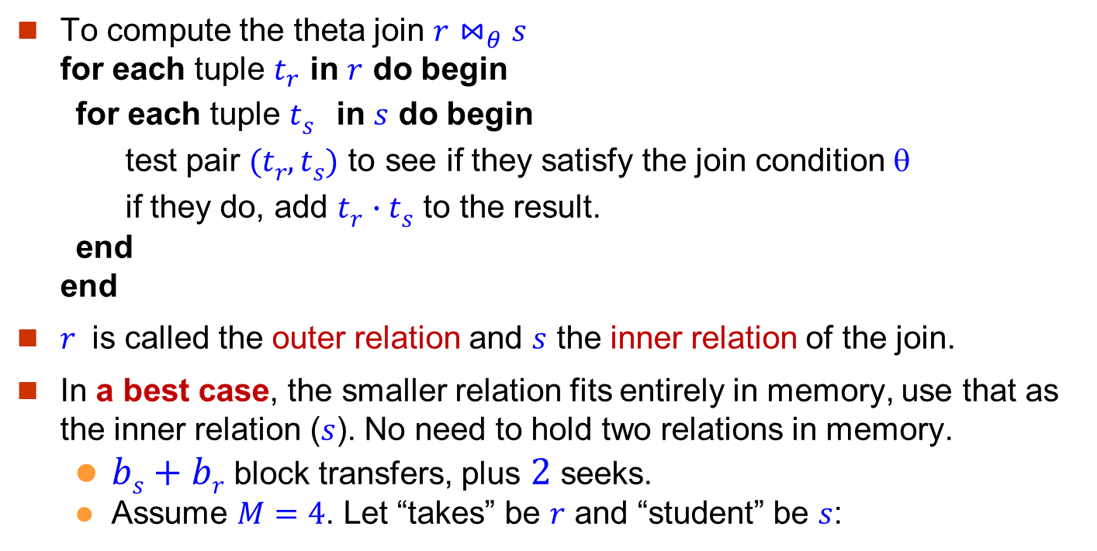
Nested-Loop Join (2)
To compute the theta join $r⋈_{θ}s$ for each tuple $t_{r}$ in $r$ do begin for each tuple $ts$ in $s$ do begin test pair $(tr,ts)$ to see if they satisfy the join condition $$ if they do, add $tr∙ts$ to the result. end end
$r$ is called the outer relation and $s$ the inner relation of the join.
In a best case, the smaller relation fits entirely in memory, use that as the inner relation ($s$). No need to hold two relations in memory.
$bs+br$block transfers, plus $2$seeks.
Assume $M=4$. Let “takes” be $r$ and “student” be $s$:
student
takes
D1 D2 D3 D4
D1 D4 D2 D3
D1 D2 D1 D4
b1
b2
b1
b2
b3
b4

Slide 24
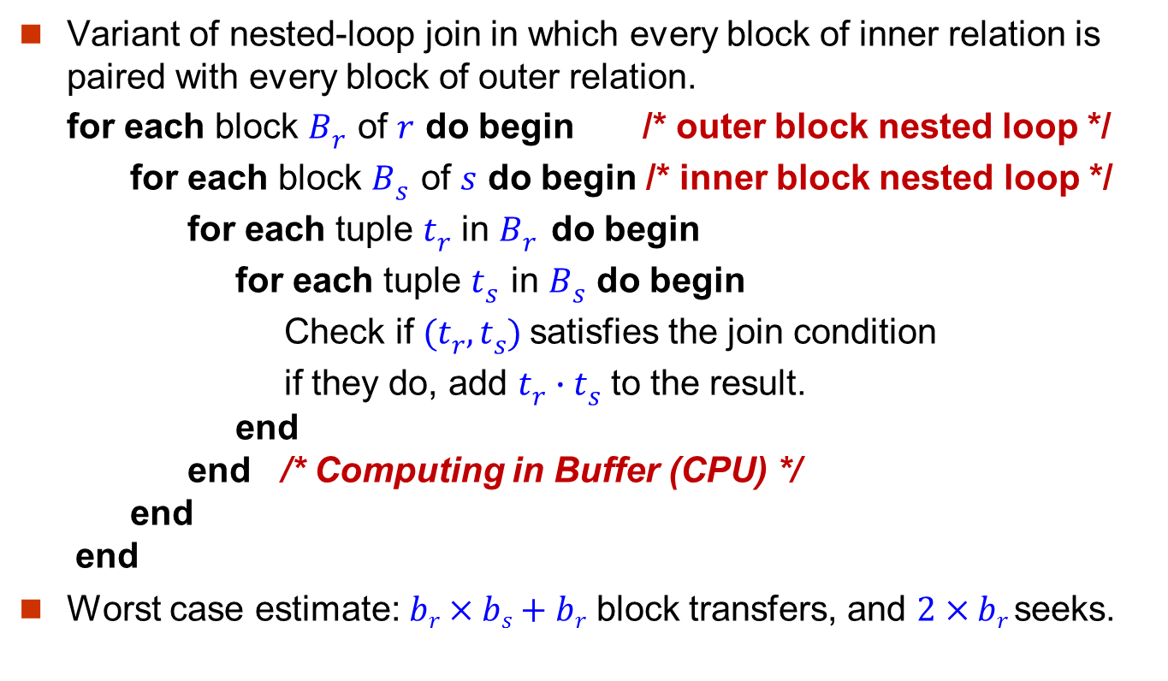
Block Nested-Loop Join (1)
Variant of nested-loop join in which every block of inner relation is paired with every block of outer relation. for each block $Br$ of $r$ do begin /* outer block nested loop */ for each block $Bs$ of $s$ do begin /* inner block nested loop */ for each tuple $tr$ in $Br$ do begin for each tuple $ts$ in $Bs$ do begin Check if $(tr,ts)$satisfies the join condition if they do, add $tr∙ts$ to the result. end end /* Computing in Buffer (CPU) */ end end
Worst case estimate: $br×bs+br$ block transfers, and $2×br$seeks.
student
takes
D1 D2 D3 D4
D1 D4 D2 D3
D1 D2 D1 D4
b1
b2
b1
b2
b3
b4

Slide 25
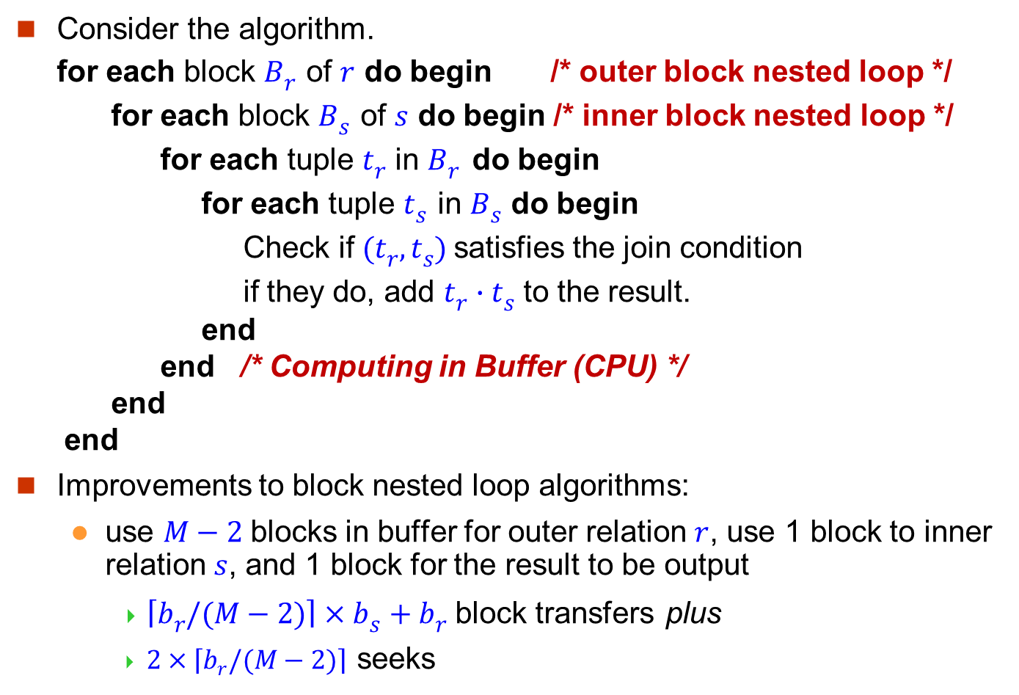
Block Nested-Loop Join (2)
Consider the algorithm. for each block $Br$ of $r$ do begin /* outer block nested loop */ for each block $Bs$ of $s$ do begin /* inner block nested loop */ for each tuple $tr$ in $Br$ do begin for each tuple $ts$ in $Bs$ do begin Check if $(tr,ts)$satisfies the join condition if they do, add $tr∙ts$ to the result. end end /* Computing in Buffer (CPU) */ end end
Improvements to block nested loop algorithms:
use $M−2$blocks in buffer for outer relation $r$, use 1 block to inner relation $s$, and 1 block for the result to be output
$\left\lceil br/(M−2)\right\rceil ×bs+br$ block transfers plus
$2×\left\lceil br/(M−2)\right\rceil$ seeks

Slide 26
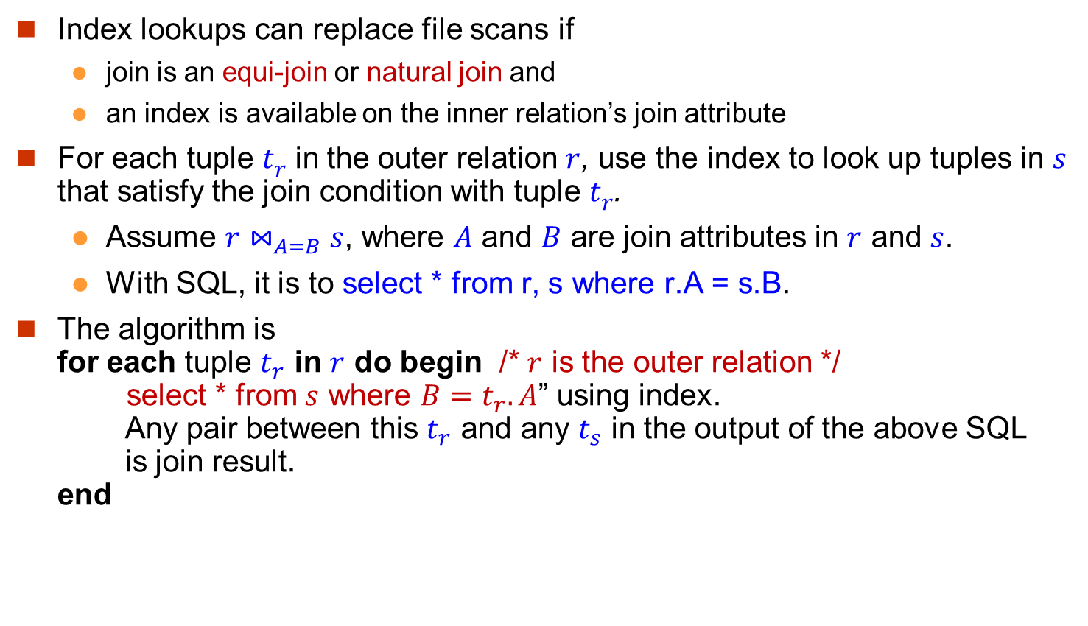
Indexed Nested-Loop Join (1)
Index lookups can replace file scans if
join is an equi-join or natural join and
an index is available on the inner relation’s join attribute
For each tuple $tr$ in the outer relation $r$, use the index to look up tuples in $s$ that satisfy the join condition with tuple $tr$.
Assume $r⋈_{A=B}s$, where $A$ and $B$ are join attributes in $r$ and $s$.
With SQL, it is to select * from r, s where r.A = s.B.
The algorithm is for each tuple $t_{r}$ in $r$ do begin /* $r$ is the outer relation */ select * from $s$ where $B=t_{r}.A$” using index. Any pair between this $t_{r}$ and any $t_{s}$ in the output of the above SQL is join result. end

Slide 27
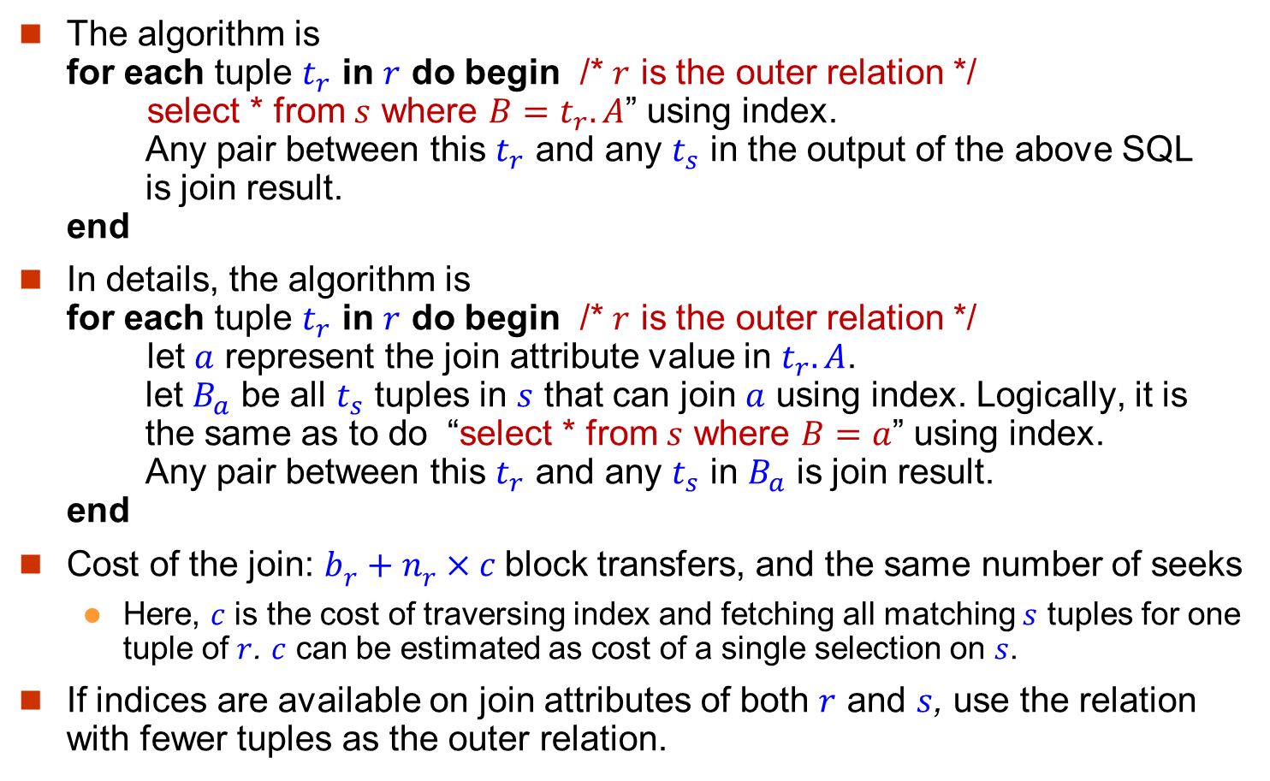
Indexed Nested-Loop Join (2)
The algorithm is for each tuple $t_{r}$ in $r$ do begin /* $r$ is the outer relation */ select * from $s$ where $B=t_{r}.A$” using index. Any pair between this $t_{r}$ and any $t_{s}$ in the output of the above SQL is join result. end
In details, the algorithm is for each tuple $t_{r}$ in $r$ do begin /* $r$ is the outer relation */ let $a$ represent the join attribute value in $t_{r}.A$. let $B_{a}$ be all $t_{s}$ tuples in $s$ that can join $a$ using index. Logically, it is the same as to do “select * from $s$ where $B=a$” using index. Any pair between this $t_{r}$ and any $t_{s}$ in $B_{a}$ is join result. end
Cost of the join: $br+nr×c$block transfers, and the same number of seeks
Here, $c$ is the cost of traversing index and fetching all matching $s$ tuples for one tuple of $r$. $c$ can be estimated as cost of a single selection on $s$.
If indices are available on join attributes of both $r$ and $s$, use the relation with fewer tuples as the outer relation.

Slide 28
An Example
We show two relations student and takes. In student, a tuple is represented by his/her ID. In takes, a tuple is represented by the ID of the student who takes this course. Consider an SQL using join. select * from student, takes where student.ID = takes.ID
The basic information.
Number of records in student: nstudent = 5,000
Number of blocks used by student: bstudent = 100
Number of records in takes: ntakes = 10,000
Number of blocks used by takes: btakes = 400

Slide 29
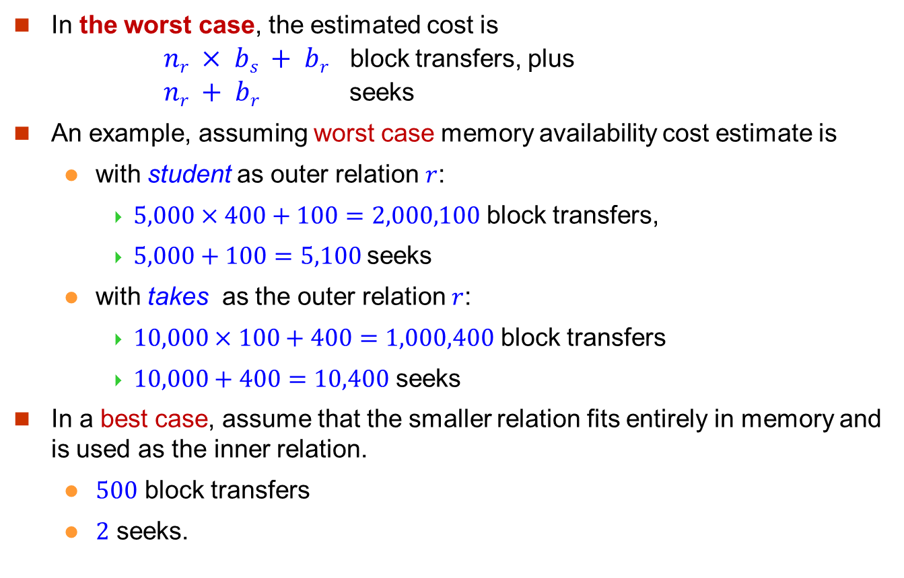
An Example: Cost of Nested-Loop Join
In the worst case, the estimated cost is $nr × bs + br$ block transfers, plus $nr + br$ seeks
An example, assuming worst case memory availability cost estimate is
with student as outer relation $r$:
$5,000×400+100=2,000,100$ block transfers,
$5,000+100=5,100$seeks
with takes as the outer relation $r$:
$10,000×100+400=1,000,400$ block transfers
$10,000+400=10,400$ seeks
In a best case, assume that the smaller relation fits entirely in memory and is used as the inner relation.
$500$ block transfers
$2$ seeks.

Slide 30
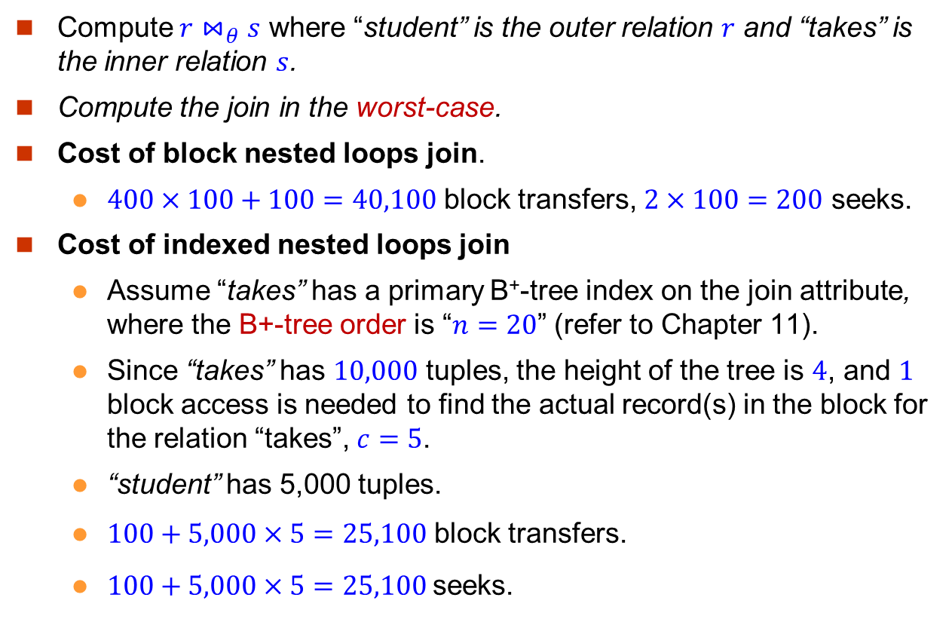
An Example: Cost of Block Nested-Loop Join and Indexed Nested Join
Compute $r⋈_{θ}s$ where “student” is the outer relation $r$ and “takes” is the inner relation $s$.
Compute the join in the worst-case.
Cost of block nested loops join.
$400×100+100=40,100$ block transfers, $2×100=200$ seeks.
Cost of indexed nested loops join
Assume “takes” has a primary B⁺-tree index on the join attribute, where the B+-tree order is “$n=20$” (refer to Chapter 11).
Since “takes” has $10,000$ tuples, the height of the tree is $4$, and $1$ block access is needed to find the actual record(s) in the block for the relation “takes”, $c=5$.
“student” has 5,000 tuples.
$100+5,000×5=25,100$ block transfers.
$100+5,000×5=25,100$seeks.

Slide 31
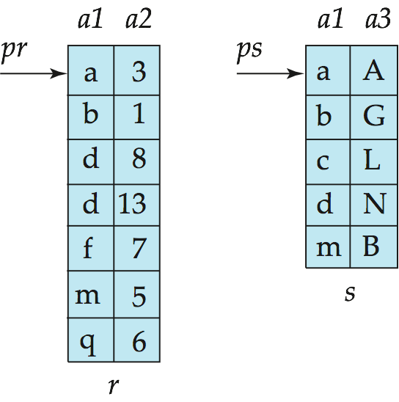
Merge-Join (1)
Sort both relations on their join attribute (if not already sorted on the join attributes).
Merge the sorted relations to join them
Join step is similar to the merge stage of the sort-merge algorithm (learned in the course of “Data Structures”.)
Main difference is handling of duplicate values in join attribute — every pair with same value on join attribute must be matched
Detailed algorithm in book (Figure 12.7).
Consider an SQL query select * from r, s where r.a1 = s.a1

Slide 32
Merge-Join (2)

Slide 33
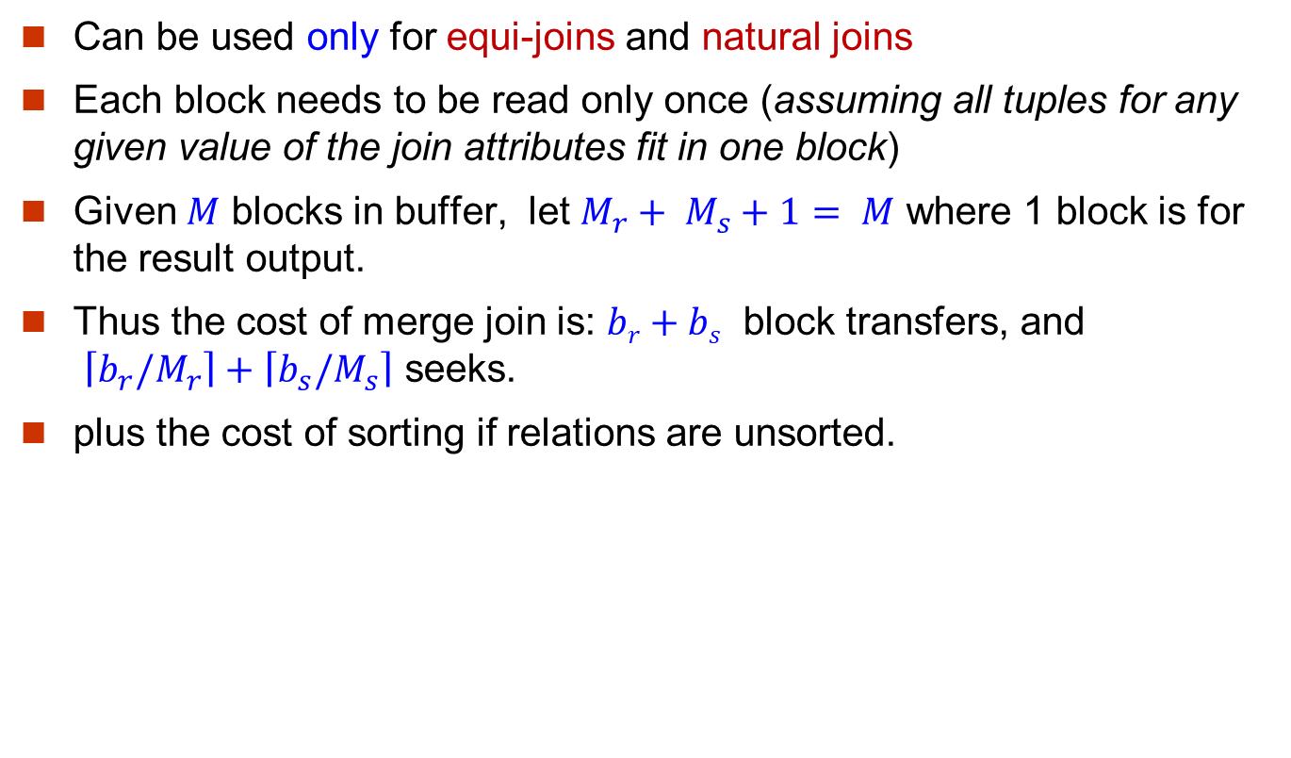
Merge-Join (3)
Can be used only for equi-joins and natural joins
Each block needs to be read only once (assuming all tuples for any given value of the join attributes fit in one block)
Given $M$ blocks in buffer, let $M_{r}+ M_{s}+1= M$ where 1 block is for the result output.
Thus the cost of merge join is: $br+bs$ block transfers, and $\left\lceil b_{r}/M_{r}\right\rceil +\left\lceil b_{s}/M_{s}\right\rceil$ seeks.
plus the cost of sorting if relations are unsorted.

Slide 34
Sorting
We may have an index on the relation, and then use the index to read the relation in sorted order.
For relations that fit in memory, in-memory sorting algorithms like quicksort can be used.
CPU cost is the only concern.
For relations that don’t fit in memory, we cannot use those in-memory sorting algorithm, and external sort-merge is the choice.
CPU cost is not the main concern.
I/O cost is the main concern.

Slide 35
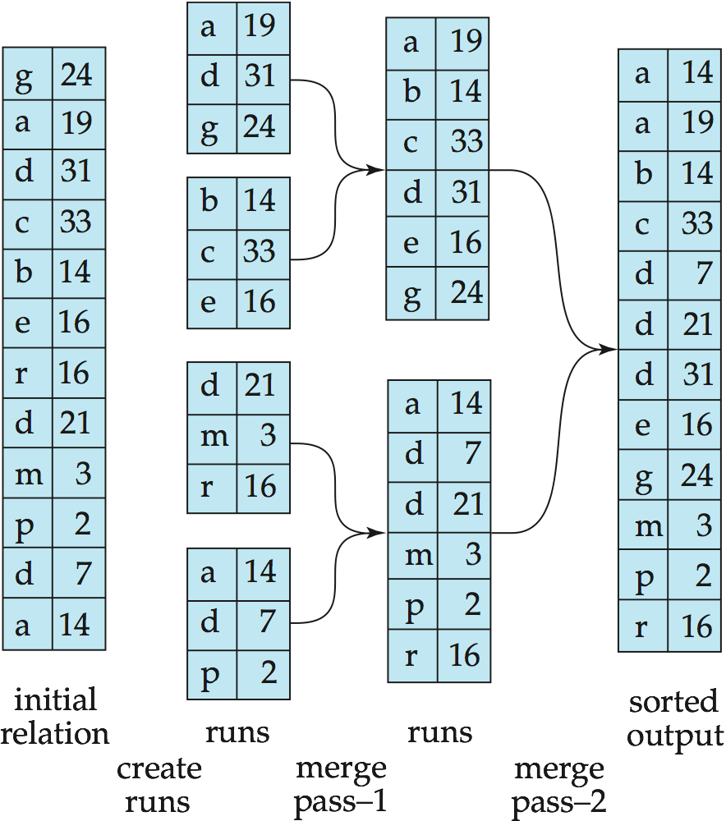
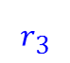
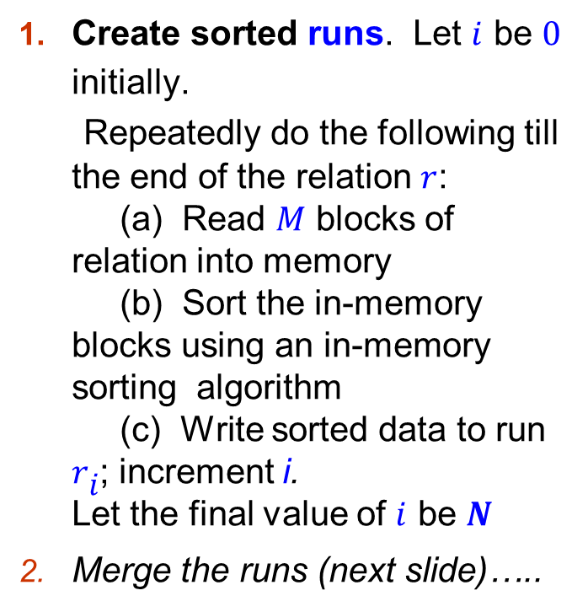
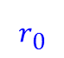
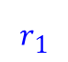
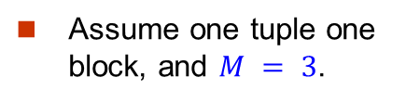
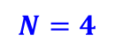
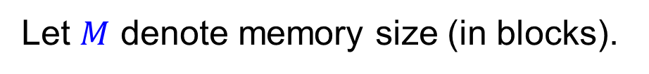
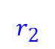
External Sort-Merge (1)
Assume one tuple one block, and $M = 3$.
Let $M$ denote memory size (in blocks).
$$N=4$$
Create sorted runs. Let $i$ be $0$ initially. Repeatedly do the following till the end of the relation $r$: (a) Read $M$ blocks of relation into memory (b) Sort the in-memory blocks using an in-memory sorting algorithm (c) Write sorted data to run $ri$; increment i. Let the final value of $i$ be $N$
Merge the runs (next slide)…..
$$r0$$
$$r1$$
$$r2$$
$$r3$$

Slide 36
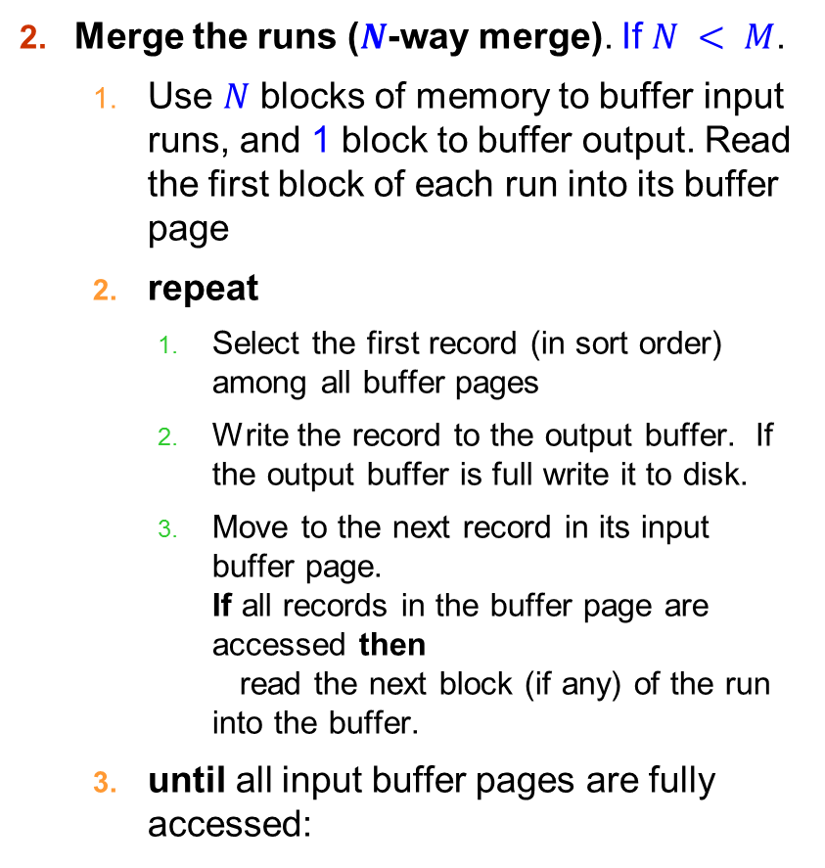
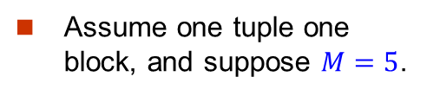
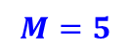
External Sort-Merge (2)
Assume one tuple one block, and suppose $M=5$.
Merge the runs ($N$-way merge). If $N < M$.
Use $N$ blocks of memory to buffer input runs, and 1 block to buffer output. Read the first block of each run into its buffer page
repeat
Select the first record (in sort order) among all buffer pages
Write the record to the output buffer. If the output buffer is full write it to disk.
Move to the next record in its input buffer page. If all records in the buffer page are accessed then read the next block (if any) of the run into the buffer.
until all input buffer pages are fully accessed:
$$N=4$$
$$M=5$$
$$r0$$
$$r1$$
$$r2$$
$$r3$$

Slide 37
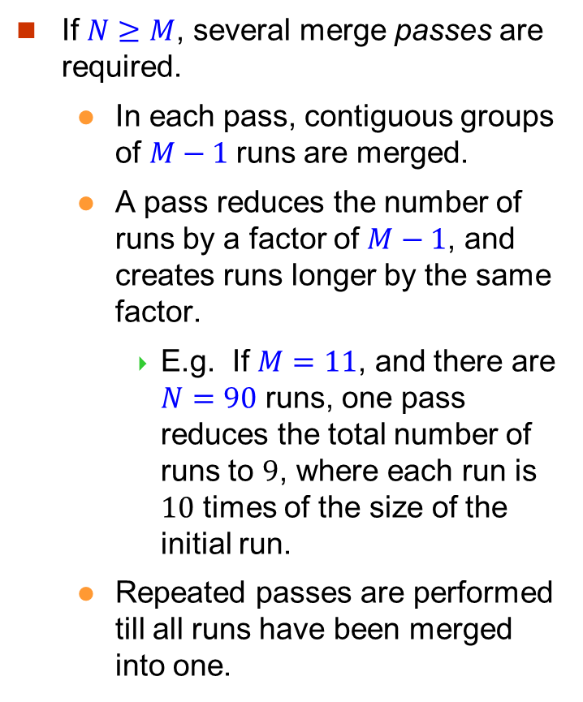

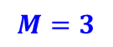
External Sort-Merge (3)
Assume one tuple one block, and $M = 3$.
If $N≥M$, several merge passes are required.
In each pass, contiguous groups of $M−1$runs are merged.
A pass reduces the number of runs by a factor of $M−1$, and creates runs longer by the same factor.
E.g. If $M=11$, and there are $N=90$ runs, one pass reduces the total number of runs to $9$, where each run is $10$ times of the size of the initial run.
Repeated passes are performed till all runs have been merged into one.
$$N=4$$
$$M=3$$
$$r0$$
$$r1$$
$$r2$$
$$r3$$

Slide 38
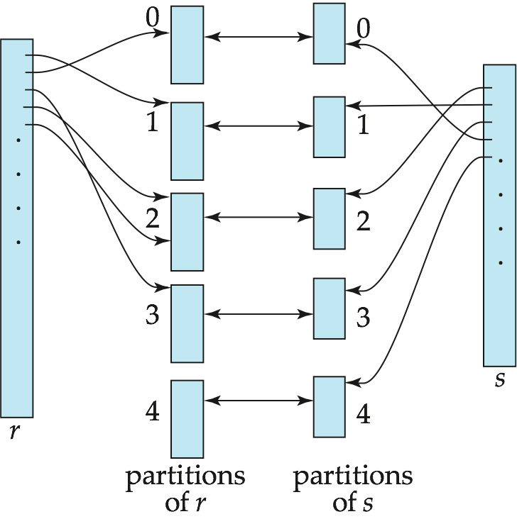
Hash-Join
Applicable for equi-joins and natural joins.
A hash function h is used to partition tuples of both relations
h maps JoinAttrs values to {0, 1, ..., n}, where JoinAttrs denotes the common attributes of r and s used in the natural join or the attributes of r and s used in the equi-join.
r₀, r₁, . . ., r_{n} denote partitions of r tuples
Each tuple t_{r} ∈ r is put in partition r_{i} where i = h(t_{r} [JoinAttrs]).
s₀, s₁. . ., s_{n} denotes partitions of s tuples
Each tuple t_{s} ∈s is put in partition s_{i}, where i = h(t_{s} [JoinAttrs]).
In book, r_{i} is also denoted as H_{ri,} and s_{i} is denoted as H_{si} and n is denoted as n_{h.}

Slide 39
Hash-Join Algorithm
The hash-join of r and s is computed as follows.
1. Partition the relation s using a hashing function h. When partitioning a relation, one block of memory is reserved as the output buffer for each partition.
2. Partition r similarly.
3. For each i:
(a) Load s_{i} into memory and build an in-memory hash index on it using the join attribute. This hash index uses a different hash function than the earlier one h.
(b) Read the tuples in r_{i} from the disk one by one. For each tuple t_{r} locate each matching tuple t_{s} in s_{i} using the in-memory hash index. Output the concatenation of their attributes.
Relation s is called the build input and r is called the probe input.

Slide 40
Other Operations
Duplicate elimination can be implemented via hashing or sorting.
On sorting duplicates will come adjacent to each other, and all but one set of duplicates can be deleted.
Optimization: duplicates can be deleted during run generation as well as at intermediate merge steps in external sort-merge.
Hashing is similar – duplicates will come into the same bucket.
Projection:
perform projection on each tuple
followed by duplicate elimination.

Slide 41
Other Operations : Aggregation
Aggregation can be implemented in a manner similar to duplicate elimination.
Sorting or hashing can be used to bring tuples in the same group together, and then the aggregate functions can be applied on each group.
Optimization: combine tuples in the same group during run generation and intermediate merges, by computing partial aggregate values
For count, min, max, sum: keep aggregate values on tuples found so far in the group.
When combining partial aggregate for count, add up the aggregates
For avg, keep sum and count, and divide sum by count at the end

Slide 42
Other Operations : Set Operations
Set operations (∪, ∩ and ⎯): can either use variant of merge-join after sorting, or variant of hash-join.
E.g., Set operations using hashing:
Partition both relations using the same hash function
Process each partition i as follows.
Using a different hashing function, build an in-memory hash index on r_{i}.
Process s_{i} as follows
r ∪ s:
Add tuples in s_{i} to the hash index if they are not already in it.
At end of s_{i} add the tuples in the hash index to the result.

Slide 43
Other Operations : Set Operations
E.g., Set operations using hashing:
as before partition r and s,
as before, process each partition i as follows
build a hash index on r_{i}
Process s_{i} as follows
r ∩ s:
output tuples in s_{i} to the result if they are already there in the hash index
r – s:
for each tuple in s_{i}, if it is there in the hash index, delete it from the index.
At end of s_{i} add remaining tuples in the hash index to the result.
Notes:
43

Slide 44
Other Operations : Outer Join
Outer join can be computed either as
A join followed by addition of null-padded non-participating tuples.
by modifying the join algorithms.
Modifying merge join to compute r s
In r s, non participating tuples are those in r – Π_{R}(r s)
Modify merge-join to compute r s:
During merging, for every tuple t_{r} from r that do not match any tuple in s, output t_{r} padded with nulls.
Right outer-join and full outer-join can be computed similarly.

Slide 45
Other Operations : Outer Join
Modifying hash join to compute r s
If r is probe relation, output non-matching r tuples padded with nulls
If r is build relation, when probing keep track of which r tuples matched s tuples. At end of s_{i} output non-matched r tuples padded with nulls
Notes:
45

Slide 46
Evaluation of Expressions
So far: we have seen algorithms for individual operations
Alternatives for evaluating an entire expression tree
Materialization: generate results of an expression whose inputs are relations or are already computed, materialize (store) it on disk. Repeat.
Pipelining: pass on tuples to parent operations even as an operation is being executed
We study above alternatives in more detail

Slide 47
Materialization
Materialized evaluation: evaluate one operation at a time, starting at the lowest-level. Use intermediate results materialized into temporary relations to evaluate next-level operations.
E.g., in figure below, compute and store then compute the store its join with instructor, and finally compute the projection on name.

Slide 48
Materialization (Cont.)
Materialized evaluation is always applicable
Cost of writing results to disk and reading them back can be quite high
Our cost formulas for operations ignore cost of writing results to disk, so
Overall cost = Sum of costs of individual operations + cost of writing intermediate results to disk
Double buffering: use two output buffers for each operation, when one is full write it to disk while the other is getting filled
Allows overlap of disk writes with computation and reduces execution time

Slide 49
Pipelining
Pipelined evaluation : evaluate several operations simultaneously, passing the results of one operation on to the next.
E.g., in previous expression tree, don’t store result of
instead, pass tuples directly to the join.. Similarly, don’t store result of join, pass tuples directly to projection.
Much cheaper than materialization: no need to store a temporary relation to disk.
Pipelining may not always be possible – e.g., sort, hash-join.
For pipelining to be effective, use evaluation algorithms that generate output tuples even as tuples are received for inputs to the operation.
Pipelines can be executed in two ways: demand driven and producer driven

Slide 50
Pipelining (Cont.)
In demand driven or lazy evaluation
system repeatedly requests next tuple from top level operation
Each operation requests next tuple from children operations as required, in order to output its next tuple
In between calls, operation has to maintain “state” so it knows what to return next
In producer-driven or eager pipelining
Operators produce tuples eagerly and pass them up to their parents
Buffer maintained between operators, child puts tuples in buffer, parent removes tuples from buffer
if buffer is full, child waits till there is space in the buffer, and then generates more tuples
System schedules operations that have space in output buffer and can process more input tuples
Alternative name: pull and push models of pipelining

